Slide 1

ENSN201 – Enterprise Social Networks
Version 2 – 18th December 2015

Slide 2
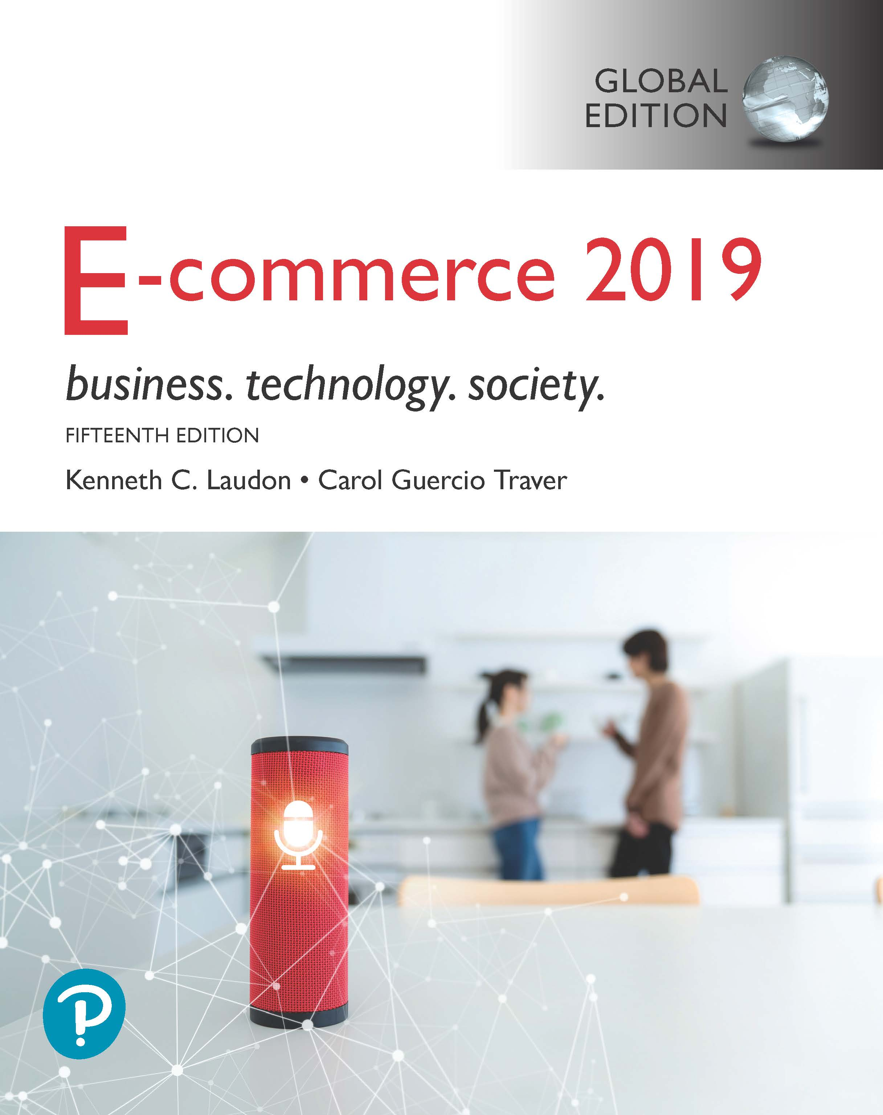
Resource Material
E-commerce 2019: Business, Technology and Society, Global Edition, 15th Edition
ISBN / EAN: 9781292303178
by Kenneth C. Laudon and Carol Guercio Traver

Slide 3
E-commerce 2019: Business. Technology. Society.
Fifteenth Edition, Global Edition
Chapter 11
E-commerce Retail and Services
Copyright © 2020 Pearson Education Ltd. All Rights Reserved
Notes:
If this PowerPoint presentation contains mathematical equations, you may need to check that your computer has the following installed:
1) MathType Plugin
2) Math Player (free versions available)
3) NVDA Reader (free versions available)

Slide 4
Learning Objectives
11.1 Understand the environment in which the online retail sector operates today.
11.2 Explain how to analyze the economic viability of an online firm.
11.3 Identify the challenges faced by the different types of online retailers.
11.4 Describe the major features of the online service sector.
11.5 Discuss the trends taking place in the online financial services industry.
11.6 Describe the major trends in the online travel services industry today.
11.7 Identify current trends in the online career services industry.
11.8 Understand the business models of on-demand service companies.
Notes:
Slide 2 is list of textbook LO numbers and statements

Slide 5
Souq.com: The Amazon of the Middle East Gets Acquired by Amazon
Class Discussion
Why is selling (or buying) over the Internet difficult?
How has Souq.com built its supply chain to keep costs low?
How has Souq.com reduced consumer anxiety over online purchases?
What are some vulnerabilities facing Souq.com?
Would you buy anything expensive via Souq.com?

Slide 6
What’s New in Online Retail
Retail mobile e-commerce exploding
Social networks experiment with social e-commerce
Local e-commerce skyrockets to around $80 billion
Online retail still the fastest growing retail channel
Selection of goods increases, includes luxury goods
Specialty retail sites show rapid growth
New subscription-based model for online retailing
Big data used for predictive marketing

Slide 7
The Online Retail Sector
Most important theme in online retailing is effort to integrate online and offline operations
$20.4 trillion U.S. economy
U.S. retail market
Personal consumption of goods and services accounts for $13.9 trillion (about 69%) of total gross domestic product (G D P)

Slide 8
The Retail Industry
7 segments (clothing, durable goods, etc.)
For each, uses of Internet may differ
Information versus direct purchasing
Mail order/telephone order (M O T O) sector
Most similar to online retail sector
Sophisticated order entry, delivery, inventory control systems

Slide 9
Figure 11.1 Composition of the U.S. Retail Industry
Notes:
Figure 11.1, Page 602
The retail industry can be grouped into seven major segments.
SOURCE: Based on data from U.S. Census Bureau, 2012.
Full description: An image shows composition of the U S retail industry. There are seven major segments of the U.S. retail industry, which are Consumer Durables, Specialty Stores, Food and Beverage, M O T O, Gasoline and Fuel, Online Retail, and General Merchandise.

Slide 10
E-commerce Retail: The Vision
The Vision
Reduced search and transaction costs; customers able to find lowest prices
Lowered market entry costs, lower operating costs, higher efficiency
Traditional physical store merchants forced out of business
Some industries would be disintermediated
Few of these assumptions were correct-structure of retail marketplace has not been revolutionized
Internet has created new venues for omni-channel firms and supported a few pure-play merchants

Slide 11
The Online Retail Sector Today (1 of 2)
Smallest segment of retail industry (about 10%)
Growing at faster rate than offline segments
Computers and consumer electronics generate highest percentage of revenue, followed by the apparel and accessories category
Around 80% of Internet users will buy online in 2018
Primary beneficiaries:
Established offline retailers with online presence (e.g., Staples)
Pure-play online retailers (e.g., Amazon)

Slide 12
The Online Retail Sector Today (2 of 2)
Omni-channel integration
Integrating web operations with physical store operations
Leverage value of physical store
Types of integration, e.g. online order, in-store pickup
Social e-commerce growth
Location-based marketing of local goods and services
Rapidly growing mobile platform

Slide 13
Figure 11.2 Online Retail Revenues by Category, 2017
Notes:
Figure 11.2, Page 605
Computers and electronics is the leading online purchase category in terms of revenue generated, accounting for over 22% of all online retail revenues.
SOURCES: Based on data from eMarketer, Inc., 2018a, 2018b; authors’ estimates.
A bar graph shows online retail revenues by category for the year 20 17. The graph shows percentage of revenue on the y axis and sales in billions on the x axis. The data is as follows. Computers and electronics, 100 billion dollars and 22.1% of sales. Apparel and Accessories, 90.15 billion dollars in sales and 19.9%. Auto and auto parts, 43.18 billion dollars and 9.5%. Furniture and home furnishings, 42.27 billion dollars and 9.3%. Books, music, and video, 33.65 billion dollars and 7.4%. Health and personal care, 30.55 billion dollars and 6.7%. Toys and hobby, 22.93 billion dollars and 5.3%. Office equipment and supplies, 12.52 billion dollars and 2.9%. Hardware and home improvement, 13.14 billion dollars and 2.9%. Food and beverage, 12.61 billion dollars and 2.8%. Specialty, 10.88 billion dollars and 2.4%. Sporting goods, 5.89 billion dollars and 1.3%. Jewelry, 3.17 billion dollars and 0.7%. Other, 31.23 billion dollars and 6.9%.

Slide 14
Figure 11.3 The Growth of Online Retail in the United States
Notes:
Figure 11.3, Page 606.
Online retail revenues will be an estimated $526 billion in 2018, and are expected to increase to $892 billion by 2022, almost doubling since 2017.
SOURCES: Based on data from eMarketer, Inc., 2018c; eMarketer, Inc., © 2018, used with permission.
Full description: A graph shows growth of online retail revenues in the United States between the years 20 13 and 20 22. The x-axis shows years and the y-axis shows revenue in billions, ranging from 0 to 900 in increments of 100. The years and the corresponding revenues are shown as follows. 20 13, 261 billion dollars. 20 14, 298 billion dollars. 20 15, 343 billion dollars. 20 16, 391 billion dollars. 20 17, 455 billion dollars. 20 18, 526 billion dollars. 20 19, 604 billion dollars. 20 20, 691 billion dollars. 20 21, 787 billion dollars. 20 22, 892 billion dollars.

Slide 15
Analyzing the Viability of Online Firms
Economic viability:
Ability of firms to survive as profitable business firms during specified period (i.e., 1-3 years)
Two business analysis approaches:
Strategic analysis
Focuses on both industry and firm itself
Financial analysis
How firm is performing

Slide 16
Strategic Analysis Factors (1 of 2)
Key industry strategic factors
Barriers to entry
Power of suppliers
Power of customers
Existence of substitute products
Industry value chain
Nature of intra-industry competition

Slide 17
Strategic Analysis Factors (2 of 2)
Firm-specific factors
Firm value chain
Core competencies
Synergies
Technology
Social and legal challenges

Slide 18
Financial Analysis Factors (1 of 2)
Statements of Operations
Revenues
Cost of sales
Gross margin
Operating expenses
Operating margin
Net margin
Pro forma earnings-Earnings before interest, taxes, depreciation, and amoritization (E B I T D A)

Slide 19
Financial Analysis Factors (2 of 2)
Balance sheet
Asset
Current assets
Liabilities
Current liabilities
Long-term debt
Working capital

Slide 20
E-commerce in Action: Amazon (1 of 3)
Vision:
Lowest prices, best selection, most customer-centric
Business model:
Retail, third-party merchants, and Amazon Web Services
Financial analysis:
Continued explosive revenue growth, profitable
Strategic analysis/business strategy:
Maximize sales volume, lower costs and prices, acquisitions, mobile shopping, new products and services

Slide 21
E-commerce in Action: Amazon (2 of 3)
Strategic analysis/competition:
Online and offline general and catalog merchandisers, web services
Strategic analysis/technology:
Largest, most sophisticated collection of online retailing technologies available
Strategic analysis/social, legal:
Sales tax, patent lawsuits

Slide 22
E-commerce in Action: Amazon (3 of 3)
Future prospects:
Amazon has turned corner to sustainable profitability
Increased profits from Amazon Web Services
Amazon Prime
Continues to invest in future products and services

Slide 23
E-Tailing Business Models
Virtual merchant
Amazon, Newegg, Overstock, Wayfair, Blue Nile
Omni-channel merchants (bricks-and-clicks)
Walmart, Macy’s, J C Penney, Staples, Target
Catalog merchant
Lands’ End, L.L. Bean, C D W Corp, Cabela’s
Manufacturer-direct
Apple, Dell, Sony
Digital native verticals: Warby Parker, Everlane

Slide 24
Figure 11.4 Share of Online Retail Sales by Type of Company
Notes:
Figure 11.4, Page 613
Virtual merchants account for 45% of online retail sales, although this percentage is heavily skewed by the dominance of Amazon, which by itself accounts for over 30%.
SOURCES: Based on data from Davis, 2018a, 2018b; eMarketer, Inc., 2016; authors’ estimates.
Full description: A pie chart shows a share of online retail sales by type of company. The information is as follows. Catalog merchants, 8 percent. Manufacturer-direct, 16 percent. Omni-channel merchants, 31 percent. Virtual merchants, 45 percent.

Slide 25
Common Themes in Online Retailing
Online retail fastest growing channel in retail commerce
Profits for startup ventures have been difficult to achieve
Disintermediation has not occurred
Established merchants need to create integrated shopping experience to succeed online
Growth of online specialty merchants (e.g., Blue Nile)
Extraordinary growth of social, local, and mobile e-commerce
Increasing use of big data analytics by retailers

Slide 26
Insight on Technology: Big Data and Predictive Marketing
Class Discussion
How does big data enable predictive marketing?
Are there any drawbacks to the increasing use of predictive marketing?
Have you experienced predictive marketing in your own shopping? If so, what was the experience like - were suggestions accurate and helpful?

Slide 27
The Service Sector: Offline and Online
Service sector:
Largest and most rapidly expanding part of economies of advanced industrial nations
Concerned with performing tasks in and around households, business firms, and institutions
Includes doctors, lawyers, accountants, business consultants, and so on
Employs 4 out of 5 U.S. workers
About 80% of U.S. G D P

Slide 28
Service Industries
Major service industry groups:
Finance
Insurance
Real estate
Travel
Professional services-legal, accounting
Business services-consulting, advertising, marketing, and so on
Health services
Educational services

Slide 29
Online Financial Services
E-commerce has transformed banking and financial services
Major institutions deploy online services
Online financial consumer behavior
Most online consumers use financial services sites
Fintech: Startup companies seeking to disrupt traditional financial services by using technology to unbundle services and deliver targeted solutions

Slide 30
Online Banking and Brokerage
Established brand-name national banks have taken substantial lead in market share
Almost 60% of U.S. adults use online banking
Online banking provides significant savings for bank
Early innovators in online brokerage (E*Trade) have been displaced by established brokerages (Fidelity, Schwab)
Online financial advisors (robo-advisors)
Examples include Betterment, Wealthfront, and Personal Capital Corp.

Slide 31
Multi-Channel versus Pure Online Financial Service Firms
Online consumers prefer multi-channel firms with physical presence
Multi-channel firms
Growing faster than pure online firms
Lower online customer acquisition costs
Pure online firms
Cannot provide all services that require face-to-face interaction

Slide 32
Financial Portals and Account Aggregators
Financial portals
Comparison shopping services, independent financial advice, financial planning
Revenues from advertising, referrals, subscriptions
Example: Yahoo! Finance, Quicken, M S N Money
Account aggregation
Pulls together all of a customer’s financial data at a personalized website
Privacy concerns: control of personal data, security, and so on
Example: Yodlee

Slide 33
Online Mortgage and Lending Services
Market is slowly growing; dominated by:
Established online banks, brokerages, and lending organizations
Traditional mortgage vendors
Pure online mortgage firms
Online mortgage industry has not transformed process of obtaining mortgage
Online lending services
Examples include Quicken Loan's Rocket Mortgage, Lending Club, Prosper, Social Finance Inc., among others

Slide 34
Online Insurance Services
Online term life insurance
One of few insurance products with lowered search costs, increased price comparison, lower prices
Most insurance still not purchased online
Online industry geared more toward
Product information, search; price discovery; online quotes; influencing offline purchase decision
Insurtech: startup companies using technologies such as big data, machine learning, and artificial intelligence to disrupt traditional insurance industry
Example: Lemonade

Slide 35
Online Real Estate Services
Early vision: Disintermediation of a complex industry
However, major impact is influence of purchases offline
Impossible to complete property transaction online
Main services are online property listings, loan calculators, research and reference material, with mobile apps increasing
Despite revolution in available information, there has not been a revolution in the industry value chain
Fintech example: OpenDoor

Slide 36
Online Travel Services (1 of 2)
One of the most successful B2C e-commerce segments
More travel is booked online than offline
Online travel services revenues in 2018: Over $200 billion
For consumers: More convenient than traditional travel agents
For suppliers: A singular, focused customer pool that can be efficiently reached through onsite advertising

Slide 37
Online Travel Services (2 of 2)
Travel an ideal service/product for Internet
Information-intensive product
Electronic product-travel arrangements can be accomplished for the most part online
Does not require inventory
Does not require physical offices with multiple employees
Suppliers are always looking for customers to fill excess capacity
Does not require an expensive multi-channel presence

Slide 38
Figure 11.5 Online Travel Services Revenues
Notes:
Figure 11.5, Page 637
U.S. online leisure/unmanaged business travel service revenues are expected to reach over $228 billion by 2022.
SOURCE: Based on data from eMarketer, Inc., 2018l; eMarketer, Inc., © 2018, used with permission.
Full description: A bar graph shows an increasing trend in revenues generated by online travel services. The x-axis shows years and the y-axis shows total online travel booking revenue in billions, ranging from 0 to 250 billion dollars in increments of 50 billion dollars. The years and the corresponding revenues are shown as follows. 20 16, 181 billion dollars. 20 17, 191 billion dollars. 20 18, 200 billion dollars. 20 19, 208 billion dollars. 20 20, 215 billion dollars. 20 21, 222 billion dollars. 20 22, 228 billion dollars.

Slide 39
The Online Travel Market
Four major sectors:
Airline tickets
Greatest source of revenue
Hotel reservations
Car rentals
Travel packages
Corporate online-booking solutions (C O B S)

Slide 40
Online Travel Industry Dynamics
Intense competition among online providers
Price competition difficult
Industry consolidation
Industry impacted by meta-search engines
Commoditize online travel
Mobile applications are also transforming industry
Social media content, reviews have an increasing influence on travel purchases

Slide 41
Insight on Society: Phony Reviews
Class discussion:
Should there be repercussions to individuals and/or businesses for posting false reviews of products or services?
Can phony reviews be recognized and moderated?
Do you rely more on some types of reviews or comments on websites and blogs over others?

Slide 42
Online Career Services
Two main players: CareerBuilder, Monster
Indeed, Glassdoor, SimplyHired, LinkedIn
Five traditional recruitment tools:
Classified and print ads, career expos, on-campus recruitment, staffing firms, internal referral programs
Online recruiting
More efficient, cost-effective, reduces total time-to-hire
Enables job hunters to more easily distribute resumes while conducting job searches
Ideally suited for Web due to information-intense nature of process

Slide 43
It’s Just Information: The Ideal Web Business?
Recruitment ideally suited for the Web
Information-intense process
Initial match-up doesn’t require much personalization
Saves time and money for both job hunters and employers
One of most important functions:
Ability to establish market prices and terms (online national marketplace)

Slide 44
Online Recruitment Industry Trends
Social recruiting
87% recruiters use social recruiting, LinkedIn
Mobile
Millennials and Gen X use primarily mobile devices
Job search engines/aggregators:
Data analytics and algorithms
Hiring by algorithm
Sifting online applications for key words

Slide 45
On-Demand Service Companies
Platforms for users to share/lease assets and resources
Bikes, cars, homes, rooms with beds, etc.
Fees collected from sellers and buyers
Use of online reputation systems, peer review
Successful firms are disrupters, lowering cost of services
Uber
Airbnb

Slide 46
Insight on Business: Food Delivery on Demand in the Middle East
Class discussion:
What features or practices have made Bawiq and Careem successful?
What challenges do grocery and meal delivery services face?
Have you used any grocery or meal delivery services? If so, what was your experience?

Slide 47
Careers in E-commerce
Position: Associate, E-commerce Initiatives
Qualification/Skills
Preparing for the Interview
Possible Interview Questions

Slide 48

Copyright

Slide 49

kent.edu.au Kent Institute Australia Pty. Ltd. ABN 49 003 577 302 ● CRICOS Code: 00161E ● RTO Code: 90458 ● TEQSA Provider Number: PRV12051

